Slide 1
Contents of this lecture
Why transport is important?
EV’s, EV policy and factors to consider when forecasting EV sales
Three case studies to explore what is occurring now in three different regions.
China
USA
Southeast Asia (SEA)

Slide 2
Why is transport important?
2nd biggest energy user (27% APEC) and emitter (19% APEC)
Largest in terms of total import/exports
energy security
affordability
EV’s and other technologies have high potential to reduce energy and emissions intensity

Slide 3
Why are EVs so important?
Passenger internal combustion engine (ICE) use almost 50% of APERC transport energy use. Most of these can be turned into EV’s. Heavy freight trucks and some rural vehicles are less likely.
Generally, 3 times more efficient than ICE
No oil required! This improves:
Energy security
Exhaust fumes
Emissions (In all cases)
Cost (potentially higher short-term cost)
Lifecycle emissions are lower in almost all cases. And are likely to continue to improve.
Compared to other technologies, they are proven and much more likely to succeed for most economies

Slide 4
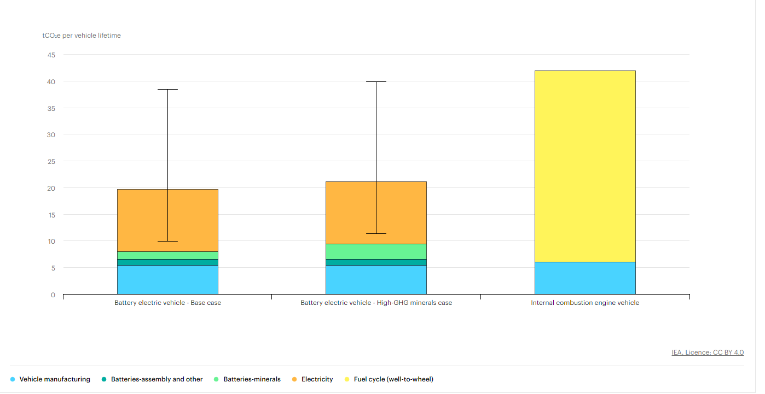
An in-depth look at the IEA’s lifecycle emissions analysis
Notes
The “High-GHG minerals” case assumes double the GHG emission intensity for battery minerals (70 kgCO2-eq/kWh compared to 35 kgCO2-eq/kWh in the base case; other assumptions are the same).
This is the most complex part in this graph because they showed it in kgCO2-eq/kWh.
Still, it’s effect is inconsequential.
The values are for a vehicle manufactured from today’s manufacturing lines.
Perhaps it would be useful to see a range for the emissions intensity of this.
Electricity carbon intensity is based on the IEA Sustainable development scenario for the vehicle’s lifetime (200,000 km lifetime mileage)
The ranges shown for BEV represent cases for charging with a static low-carbon (50 gCO2-eq/kWh) and high-carbon electricity mix (800 gCO2-eq/kWh).
Avg carbon intensity in the world is 450, and the highest in APEC is 685 (Hong Kong)
Note that this is for ‘mid sized’ vehicles. How would you expect a large SUV’s emissions to change by drive type?
Sources
IEA analysis based on IEA (2020c); Kelly et al. (2020); Argonne National Laboratory (2020)
https://www.iea.org/data-and-statistics/charts/comparative-life-cycle-greenhouse-gas-emissions-of-a-mid-size-bev-and-ice-vehicle

Slide 5
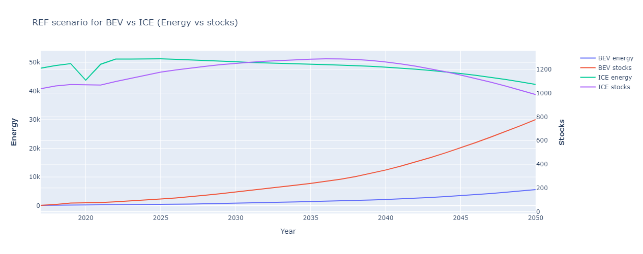
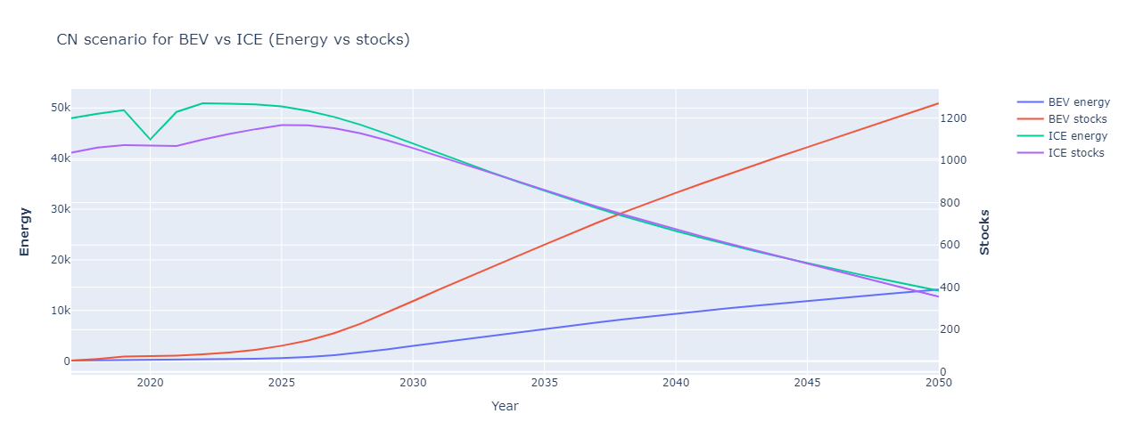
Electric Vehicles introduction
These are our forecasts for passenger EV stocks and their resulting effects on energy use.
See how slowly BEV energy use changes compared to stocks.
Other types of EV vehicles are expected to be used for niche cases (e.g. hybrids for rural households). But they were insignificant in our forecasts.

Slide 6
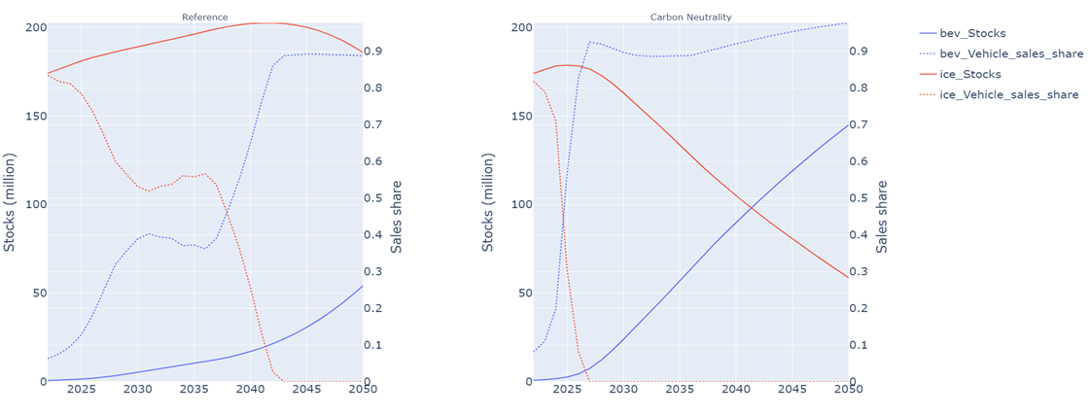
Vehicle sales shares for EV’s vs ICE’s in light vehicles
Please observe the relationship between sales share (dashed) and stocks (solid)
The vehicle sales share was an assumed, and not estimated in the 8th Edition Outlook. Therefore, it is important to consider carefully.

Slide 7
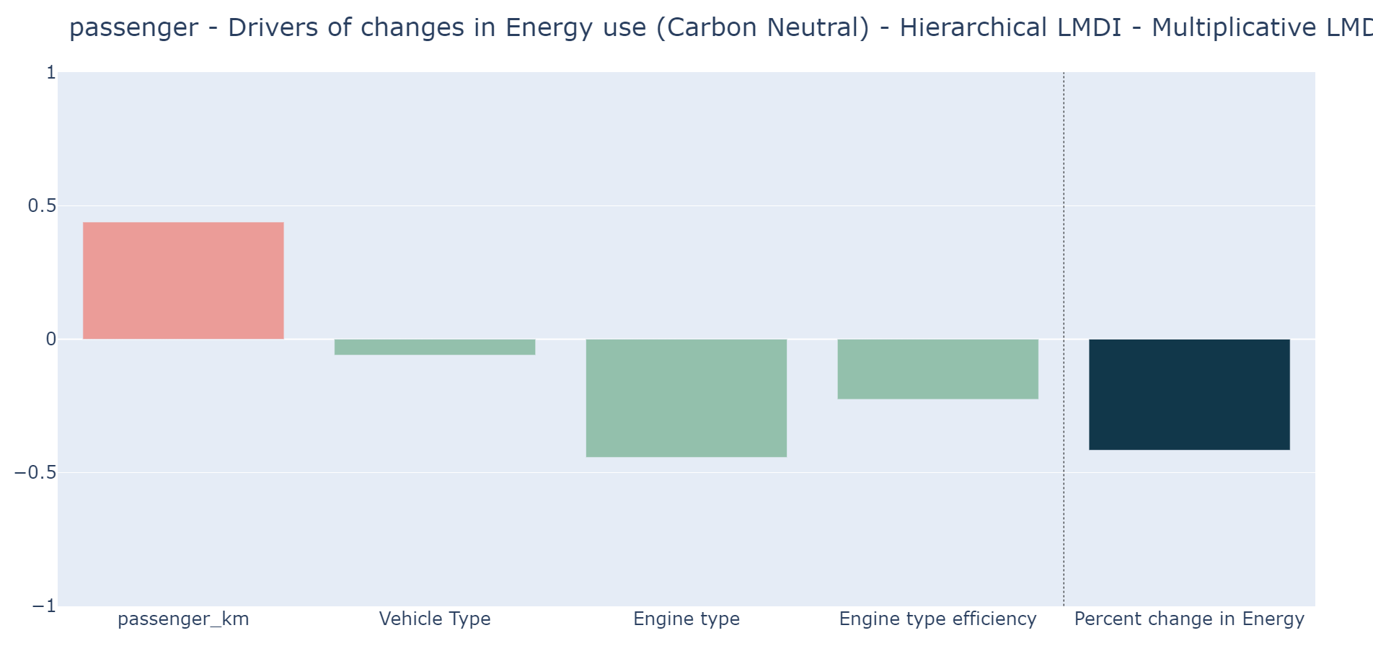
Understanding the effect of EV uptake on changes in energy use
Graphs show drivers of changes in energy use*
Passenger_km = km travelled * occupancy
Vehicle type = different modes of transport (e.g. shifting to rail, bus etc.)
Engine type = effect of changing ICE to EV’s
Engine type efficiency = inherent effect of improvements to engine efficiency (after considering effect of changing engine type)
This slide uses the hierarchical LMDI method. I have provided a hidden slide in this file in case you want to find out more.

Slide 8
The LMDI method used in previous slide:
Divisia decomposition methodolody: https://bit.ly/3N8ytIJ
Spreadsheets to produce simplified Divisia analysis:
Freight https://bit.ly/3w3BLr2
Passenger: https://bit.ly/3L0sAfj
Github repo I created that you can use to do the same analysis using different variants of the method (e.g. hierarchical method which allows you to decompose into more than 3 effects): https://github.com/asia-pacific-energy-research-centre/PyLMDI
This method is very useful but quite challenging to understand. I am very happy to help anyone with understanding it if they have questions.

Slide 9
LMDI examples

Slide 10
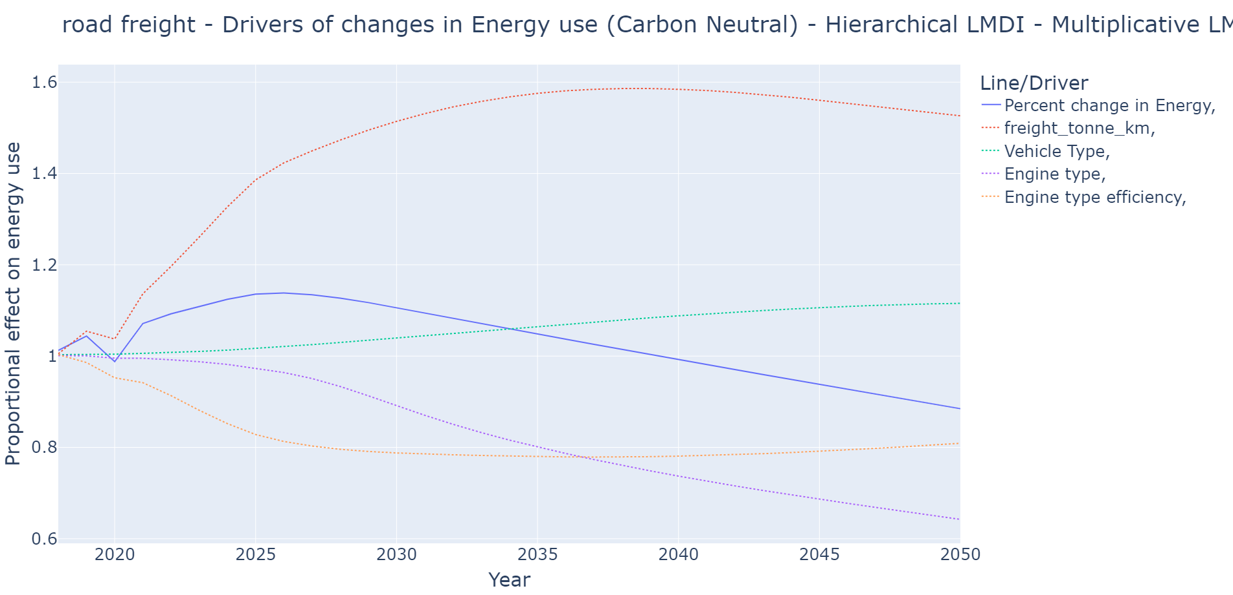
LMDI examples

Slide 11
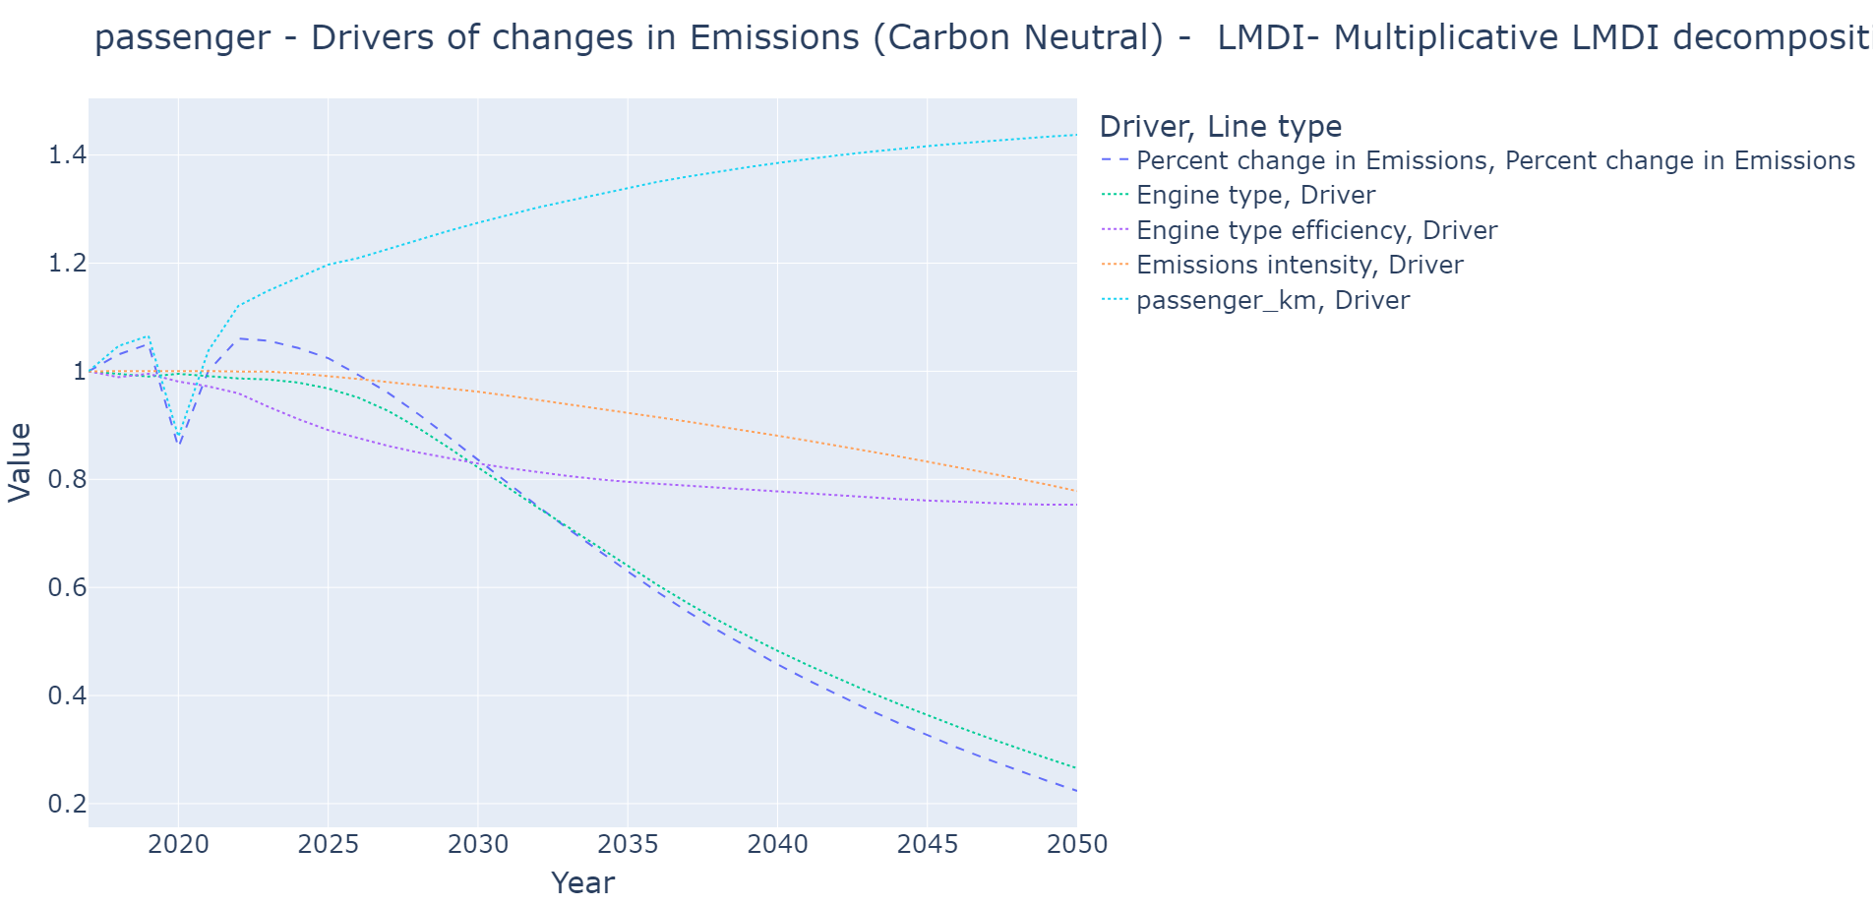
LMDI examples

Slide 12
What could go wrong with EV’s?
Charging infrastructure and transmission capacity
Battery production and how to generate required supply at low enough cost. This is in both:
Battery production
Resource extraction and refining
This is especially a problem in the next decade as supply shortages are expected
Also:
Battery safety.
Insurance issues?
Environmental effects of mining

Slide 13
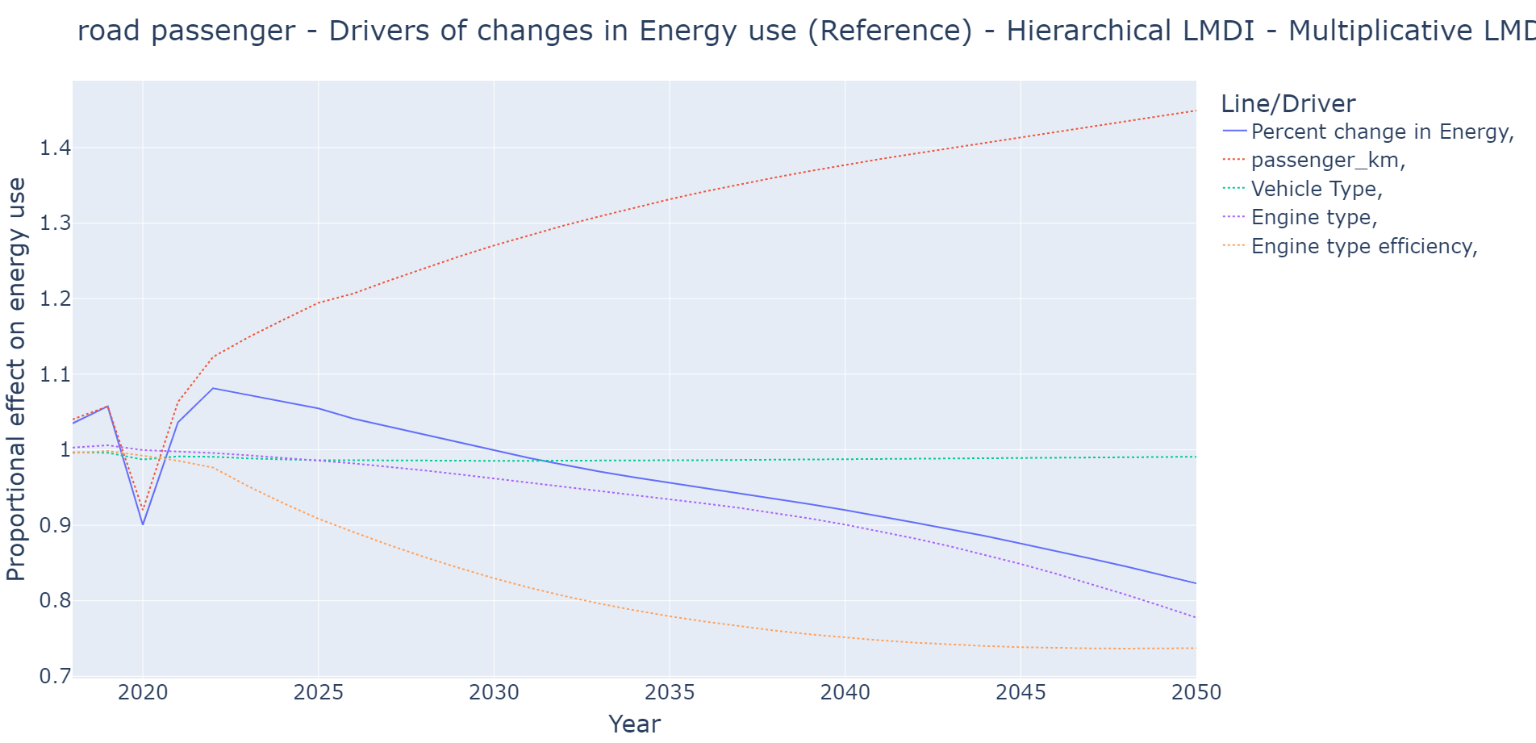
A short term alternative: ICE efficiency improvements
Historical worldwide efficiency improvement rate has been an average of 1.5% but is expected to slow (marginal cost increasing)
So long term we probably should move away from ICE’s (maximum efficiency is better)
But perhaps we could increase efficiency improvement in short/medium term at a lower cost
Very viable short-term solution if current stocks are old
This suits developing economies, especially while EV’s are ‘nascent’.
As shown in graph, our reference scenario models a slow growth in EV’s with similar efficiency growth to historical rates. See how engine type efficiency effect slows and engine type effect increases over time.

Slide 14
Biofuels
For cars, unless a country has cheap access, might increase fuel price (e.g. NZ scrapped its biofuel mandate)
Allows for decarbonization of heavy transport (including aviation) which is an issue for electricity (related to energy to weight ratio)
Simple, e.g. ethanol, 70% of energy per volume as gasoline
Advanced, e.g. butanol, 100% energy per vol.
“Advanced vs simple biofuels” = mixing vs pure
Advanced biofuels: don’t need to be blended with petrol/diesel because they yield about the same amount of energy per volume. Necessary for aviation.
Important to consider lifecycle sustainability (food vs fuel, deforestation etc.)

Slide 15
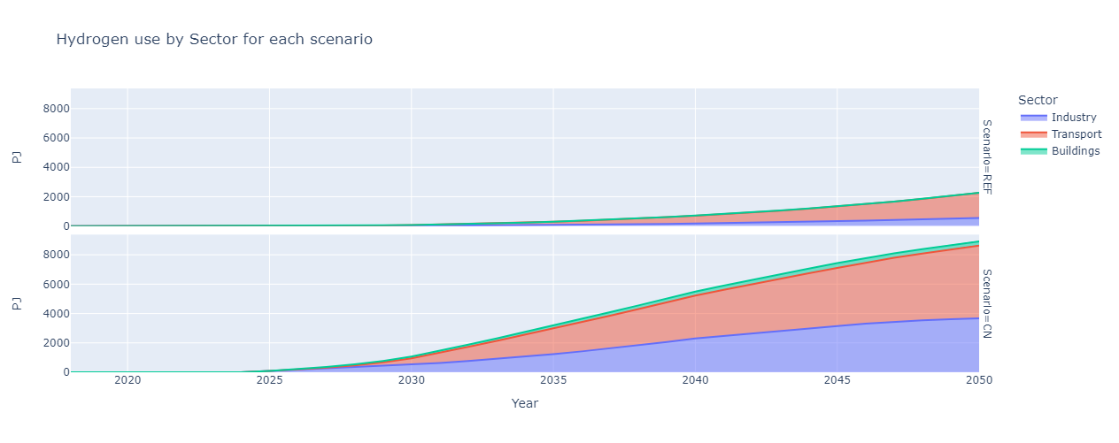
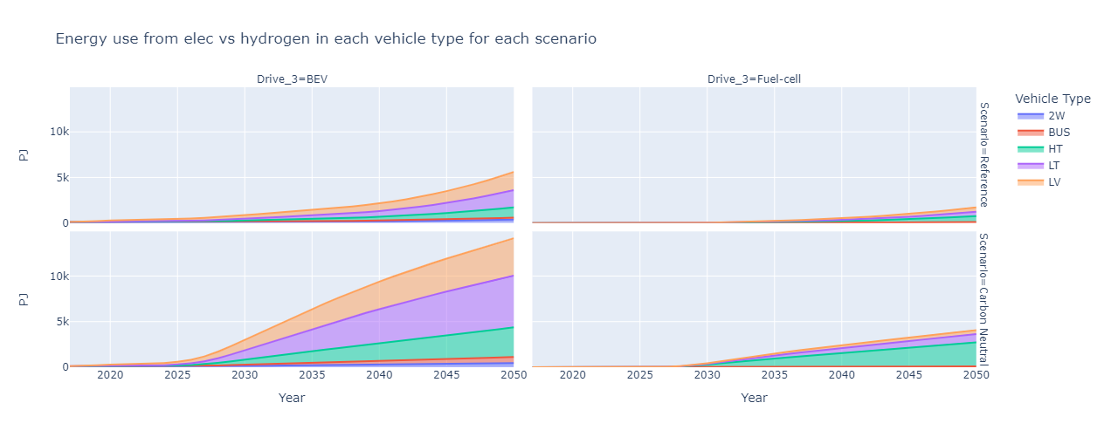
Hydrogen
Currently: expensive capital costs and relatively expensive to produce
For transport, very similar use cases to biofuels.
Similar energy to weight ratio of oil and advanced biofuels
Should consider it’s use in industrial sector more.
Chicken-egg problem with supply/demand development
Hydrogen aviation is not included in the graph above

Slide 16
Any questions? We will now look at case studies from China, USA and SEA

Slide 17
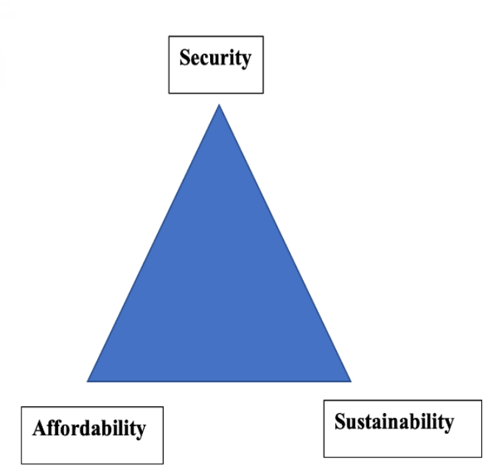
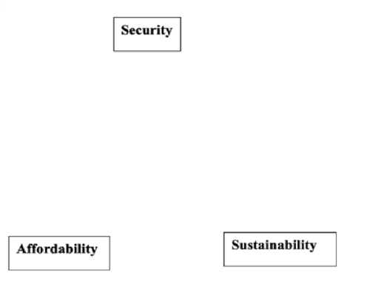
Energy trilemma framework
What politicians see
Energy policy alternatives and challenges in three APEC subregions will be examined in depth to highlight the trade-offs between energy affordability, security, and sustainability.
They are interrelated (especially over the long term)
Governments will focus on certain priorities more at different times. Like the focus on security lately.
For some economies, like Papua New Guinea, Affordability goal is the same as ‘Access’
Very few good transport policies will have negative effects on any of these factors
What economists see
Notes:
Security : diversification, resilience, integration, and transparency.

Slide 18

China – setting the scene
Even if you ignore emissions, China needs to consider:
Energy security concerns:
Strong refining sector but
60% of crude is imported
A trade embargo could raise crude price to unaffordable prices
Air quality concerns
As labour costs rise, should move manufacturing to more skilled and value adding exports.
Picture: Ding Liren, the new Chinese world chess champion

Slide 19
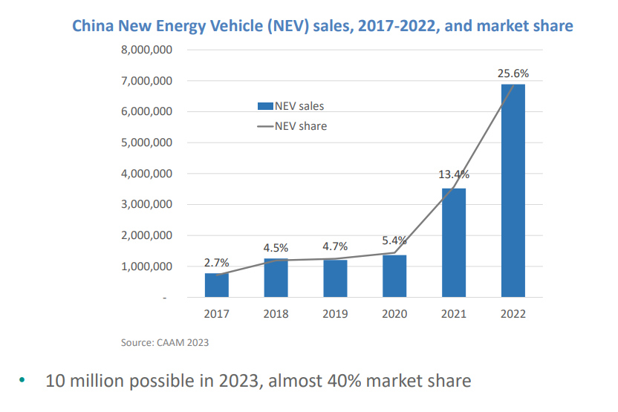
China’s EVs push
In 2007 China invested over RMB2 billion (US$300 million) in new energy vehicle development.
Now they already have a high EV sales share (10 million possible in 2023, almost 40% sales share)
China are now ahead of their EV targets
Consumer surveys show: EV’s have become more desirable than ICE’s
The largest producer of EVs (> 50%)
Export market beginning to grow
Great presentation/podcast about this from which most of this info (and graphs) are from: https://www.oxfordenergy.org/publications/an-update-on-chinas-ev-revolution/

Slide 20
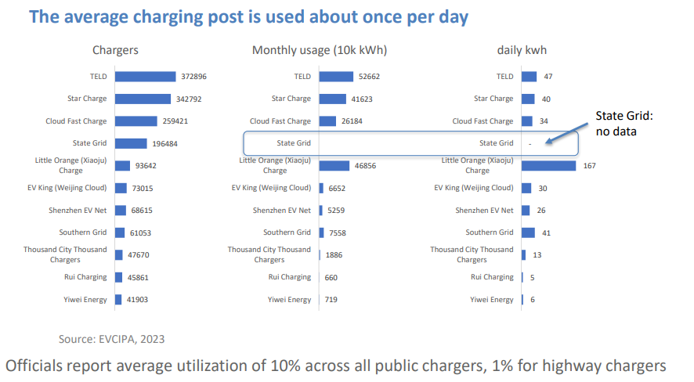
China EVs - public charging:
Likely that large fraction of drivers use public charging regularly
(December consumption represents 140 kWh per vehicle, sufficient for 1000 km – avg. yearly km is ~20,000 to 15,000km)
Low utilization rate for public chargers ->
Maintenance and operation issues result
Highway chargers are only used in public holidays
Great presentation/podcast about this from which most of this info (and graphs) are from: https://www.oxfordenergy.org/publications/an-update-on-chinas-ev-revolution/

Slide 21
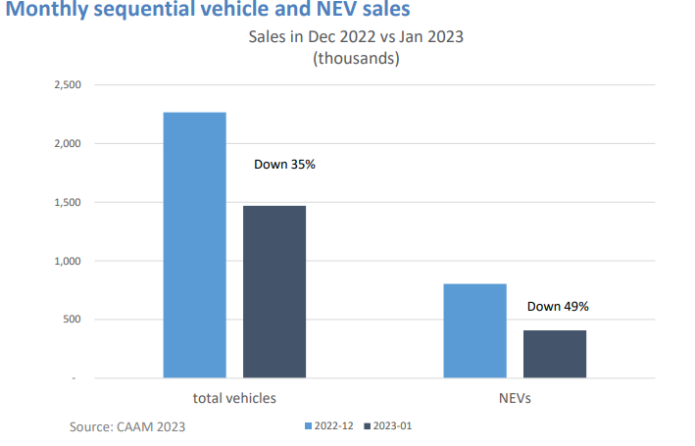
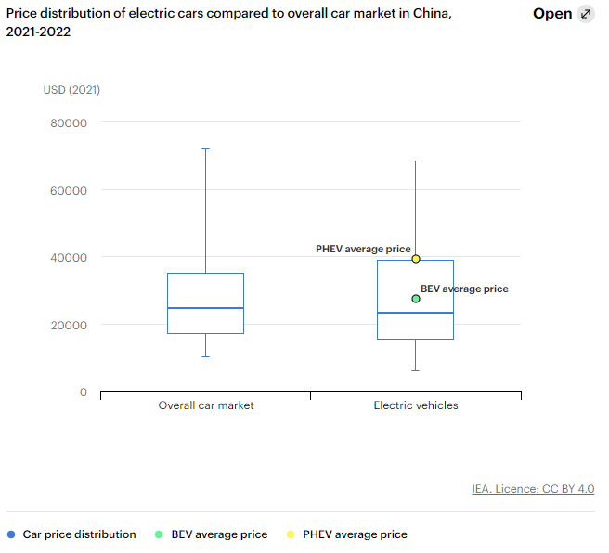
China EVs subsidies dropped, is this price parity?
Subsidies dropped in 2023 -> drop in EV sales (on top of CNY effect)
But sales still high
Dropping subsidies implies that EVs are at/near cost parity
Probably will start exporting soon too.
Will price continue to fall?
- Looming battery scarcity issues
- Global economic fragility
+ Technological learning curves
= Long term likely, short term maybe

Slide 22


USA EV’s – an overview
A relatively slow (or careful) start
Big cars with long range requirements
As things stand, security is not impacted as beneficially, unless production and resource extraction is kept onshore/within alliances.
America needs to stimulate this production/extraction, or it will be difficult to transition to EV’s without compromising energy security
Need to build out charging.

Slide 23
Inflation Reduction Act (IRA) and the Bipartisan Infrastructure Law (BIL)
IRA estimates:
Large incentive (expected average of $6.45k per vehicle) to EV’s.
~$5,000 tax credit to consumers for purchasing qualified EVs ($7.5B)
~$1,450 average battery production tax credit (also affect battery production for other uses) ($2B)
BIL estimates:
Also consider Bipartisan Infrastructure Law from Nov 2021:
$7.5billion to deploy a national network of 500,000 electric vehicle chargers (as much as is spent on consumer tax credit!)
More than $7 billion to ensure domestic manufacturers have the critical minerals and other components necessary to make EV batteries
To put these big numbers into perspective:
7.5 + 2 + 7.5 + 7 = $24B
That is, 8 cents per person, 6% of the IRA total, 0.4% of federal government spending for 2022, and 0.1% of total GDP!
This will help the US transition it’s automotive industry and stimulate demand for the new production of EV’s. It will be interesting to see the results
We have already seen $52 billion in post-IRA investments into North American EV supply chains.
Values from https://theicct.org/wp-content/uploads/2023/01/ira-impact-evs-us-jan23-2.pdf and https://decarbonization.visualcapitalist.com/breaking-down-clean-energy-funding-in-the-inflation-reduction-act/

Slide 24
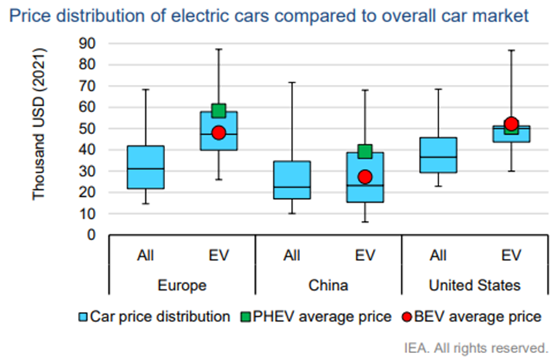
USA EVs – will the sales share of EVs increase?
As of 2022, USA BEVs are ~US$15,000 more expensive on average.
Whereas Chinese BEVs are near price parity
But US uses bigger cars with more range (production has also been focused on this)
~6.5k avg IRA incentive for a BEV from now until 2030. Speeds up the progress to price parity
From IEA EV vehicle outlook

Slide 25

A recent study by Bloomberg found that American drivers expect a range of 300 miles from their EVs. That figure, which is increasingly becoming the standard for premium battery-powered vehicles sold in the U.S., is far higher than the expectation of drivers in Europe and China.
https://www.bloomberg.com/news/articles/2023-05-04/americans-insist-on-300-miles-of-ev-range-they-re-right?in_source=embedded-checkout-banner

Slide 26
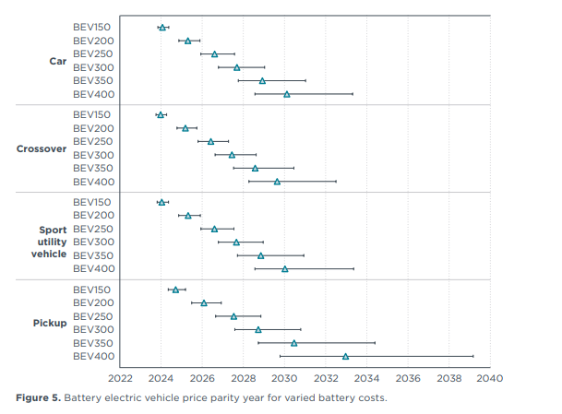















Price parity expectations
BEV300 refers to 300miles per charge. Generally, you should fill your EV to 90%, so that’s ~4-6 hours on highways.
Expectation: 2027-2028 for price parity for 300mile range vehicles
This doesn’t include 6.5k subsidy for IRA!
This graph suggests that range is the most important factor for when a BEV will achieve price parity. All car weights have similar price parity expectations.
https://theicct.org/wp-content/uploads/2022/10/ev-cost-benefits-2035-oct22.pdf
Notes:
Current avg is like 220miles per charge

Slide 27
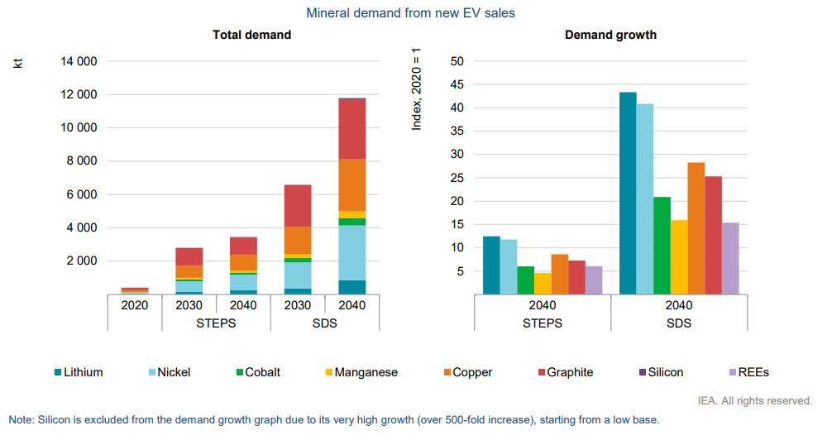
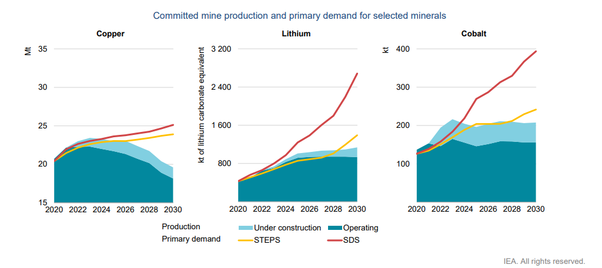
Impending storm: Resource extraction and refining
EVs use around six times more minerals than conventional vehicles. These are also harder to extract and refine.
For mines, global average lead times from discovery to production are about 17 years
There are security of supply concerns for everyone except China:
China controls 80% of rare earth materials with new SOE
50% or more of copper refining with comparable shares for other metals;
~70-80% or more of large format battery manufacturing capacity
All figures based on world totals. From IEA: The Role of Critical Minerals in Clean Energy Transitions

Slide 28
An interesting question to consider:
Why is the USA subsidizing it’s EV’s if price parity is expected to come in 2028 anyway?
Keeping up with global automotive competition?
Speed up EV transition?
Managing price parity risks?
Political play?

Slide 29
US summary and concerns
IRA subsidy should speed up arrival of price parity to pre-2028 for 300mile range vehicles
300mile range requirement delays price parity by at least a year
Price parity could come late if resource extraction and refining problem is not solved
How will the public chargers rollout go?

Slide 30
Southeast Asia
Low energy use compared to other regions but very fast growth
Interests in developing and subsidising EV manufacturing sectors
Fuel subsidy users
More EV’s mean less spent on fuel subsidy
High amount of 2W (about 12.5% of total energy use, compared to <1% in most other economies)
Low cost of ownership
More suited to the cities and traffic
As income rises, probably will slowly shift to cars, but not fast enough that 2W should be ignored.

Slide 31
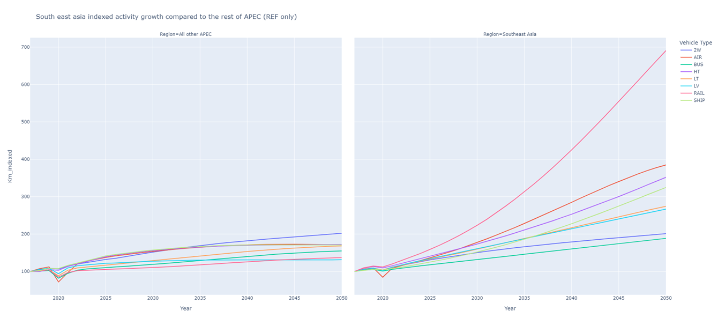
Growth in SEA
High expected growth in all vehicle types.
Therefore, important to plan for increased energy use.

Slide 32
2W progress
Batteries are the major cost
IEA analysis on the TCO (total cost of ownership) in India suggests that electric three-wheelers are already 70% cheaper than their gasoline-power ICE equivalents over their lifetime (IEA, forthcoming)*
Innovative demand incentives seen in India:
battery-as-a-service (BaaS) business model
Decreases upfront cost (important since TCO is 70% cheaper)
draft battery swapping policy
Decreases range anxiety and charging time
Data difficult to find!
https://www.iea.org/reports/global-ev-outlook-2023/trends-in-electric-light-duty-vehicles

Slide 33
Indonesian case study – an EV hub?
Indonesia is currently the second-largest automotive producer in the Southeast Asian region, behind only Thailand, with 900,000 passenger vehicles produced in 2021.
They are planning (and have the ability) to become a major player in the global EV market:
Indonesian nickel export ban (2020):
Makes battery production within the economy attractive, which is intended to stimulate an EV manufacturing industry
In 2022 Indonesia became the 2nd largest producer of cobalt
March 2023: introduced subsidies for domestic EV production.
They are also exploring policy to encourage swappable batteries between bikes from different producers and battery-as-a-service (BaaS) business model
Other SEA economys (Thailand, Vietnam, Malaysia) are also encouraging domestic production

Slide 34
Fossil fuel subsidies
Started off to keep price stable.
Now ‘addictive’ politically
Analysis shows they now are too expensive.
Will get more expensive as growth persists
Fossil fuel subsidies decrease demand for EV’s.
Increased demand for EV’s decreases money spent on subsidies.

Slide 35
SEA summary
2W’s not there yet. Demand side policy and/or production subsidies required to lift sales share.
Big push to develop domestic EV production in most SEA countries.
EV’s are a good way to avoid fossil fuel subsidies.
In the next page we will analyse the trade-offs between energy affordability, security, and sustainability for SEA EV policy.

Slide 36
SEA EV policy energy trilemma analysis
Are EV’s beneficial for SEA?
What policies are effective for SEA to increase EV sales?
How do they measure in terms of the trilemma (Security, Affordability, Environment)?
What are some potential downsides or risks?
What are some alternatives?

Slide 37
This lecture summarized:
EV’s are a great opportunity and can have positive impacts on all aspects of the energy trilemma
However, they do have some issues:
Resource extraction / refining
Non-China production ramp-up required to improve security
Charging investments required
Price parity is still a few years away… and what happens if cost of raw materials increases?
China is already on the ‘road’ to success
USA has now made their investments, now we need to see if it is enough
SEA are showing a lot of interest in production. They have a lot to gain from improving vehicle efficiency and avoiding fuel subsidies. Keep an eye out for investments and new policies.

Slide 38
Thank you
Finbar Maunsell
finbar.maunsell@aperc.or.jp

